Slide 1



The Future of
Biotechnology
in Sri Lanka
Sewwandi H. G. I.
HS26510452
SC1172 – Introduction to Information Technology
BSc (Hons) in Biotechnology

Slide 2


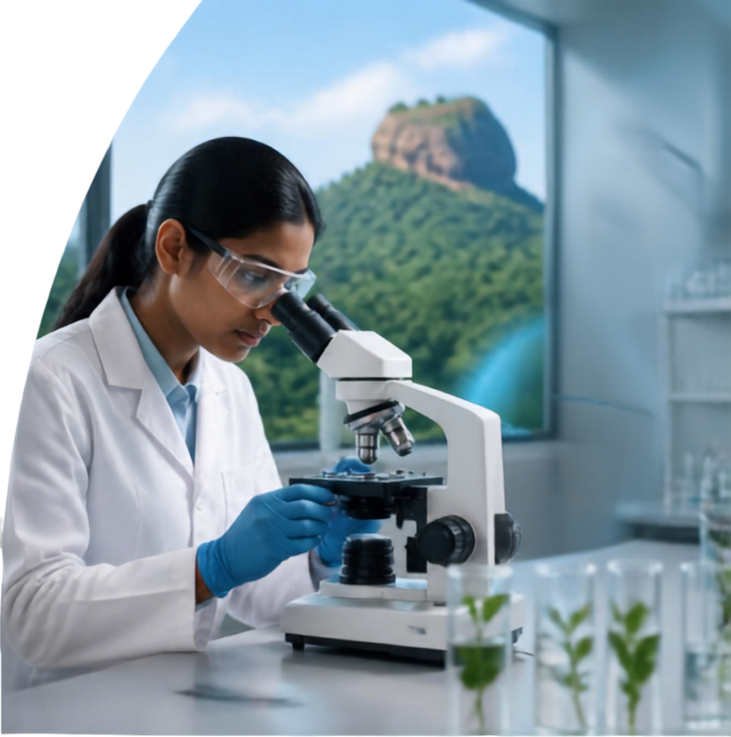


Introduction to
Biotechnology
Biotechnology combines biology and technology to improve life.
KEY IMPACT AREAS FOR SRI LANKA
Improving crop yields
Producing medicines
Protecting the environment
Powering a healthier, greener, more prosperous Sri Lanka.

Slide 3


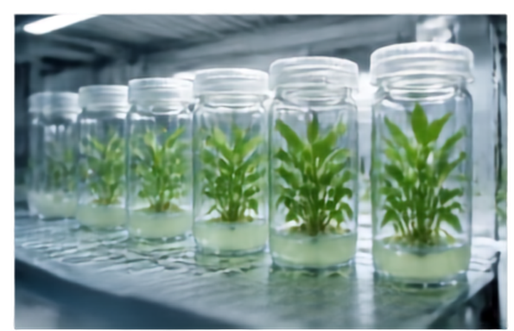
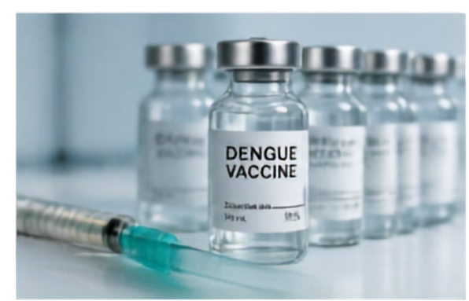
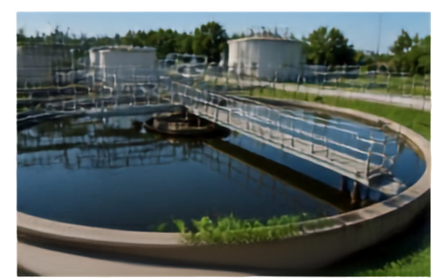



Applications of Biotechnology in Sri Lanka
Agriculture and Crop Improvement
Healthcare and Medical Biotechnology
Environmental Biotechnology
Use of tissue culture to produce disease-free plants
Production of vaccines and diagnostics
Bioremediation to clean polluted water
Example: Tissue cultured banana plants
Example: Dengue vaccine research
Example: Using microbes to treat industrial waste
Benefit: Higher yields and disease resistance
Benefit: Better disease control
Benefit: Cleaner environment
The Future of Biotechnology in Sri Lanka
SC1172 – Introduction to Information Science

Slide 4






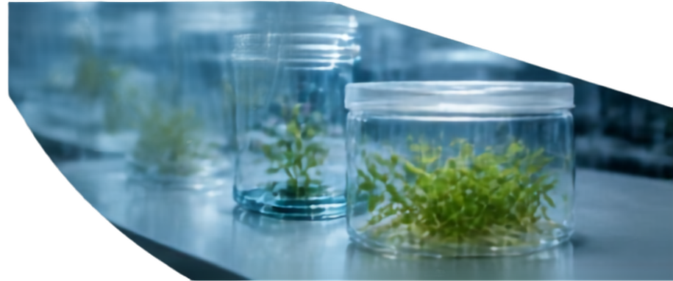
Emerging Biotechnology Technologies
CRISPR and Gene Editing
Precise DNA changes to improve crops and medicines
Driving
improved crops, better healthcare, and stronger research in
Sri Lanka
Genetic Engineering
Adding useful genes to plants and microbes
Bioinformatics and AI
Using computers to analyze biological data
Synthetic Biology
Designing new biological parts and systems
Tissue Culture
Growing plants and cells in labs
Genomics
Studying all genes of organisms for better understanding

Slide 5


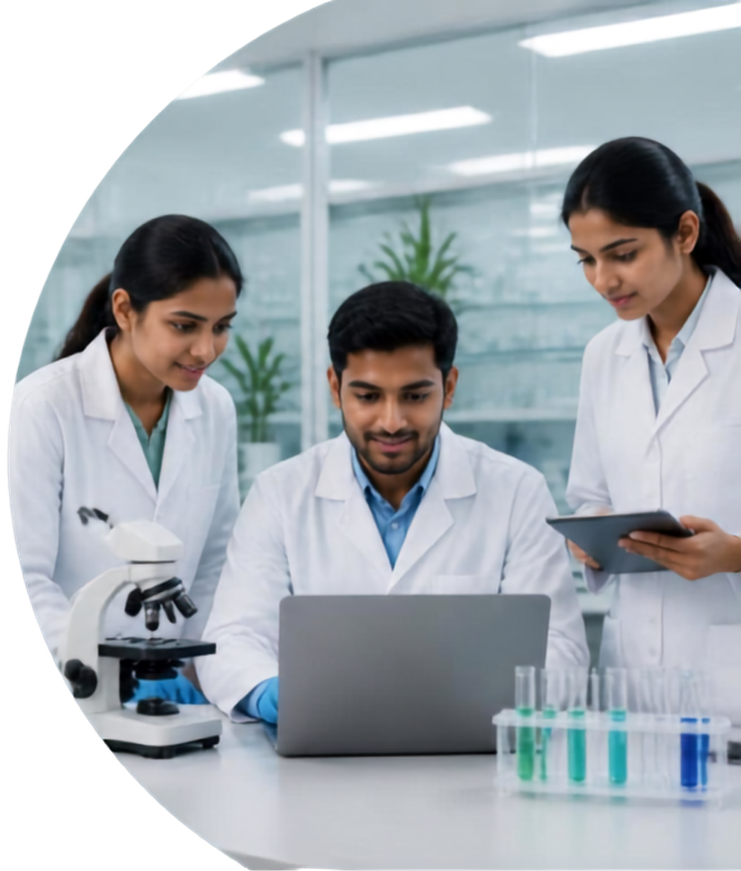





Career Opportunities in Biotechnology
CAREER PATHS
SKILLS TO DEVELOP
Research Scientist
Biotechnologist
Microbiologist
Quality Control/Assurance Officer
Bioinformatics Specialist
Agricultural Biotechnologist
Environmental Biotechnologist
Food Technologist
Laboratory techniques
Data analysis and computer skills
Communication and research skills

Slide 6


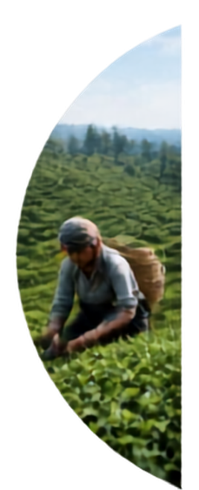
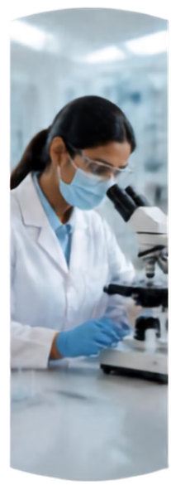









Future Opportunities and Challenges
OPPORTUNITIES
CHALLENGES
Boost agriculture productivity and food security
High cost of advanced equipment
Advance healthcare with new medicines and diagnostics
Need for skilled workforce and training
Protect environment through sustainable biotech solutions
Ethical concerns and regulation requirements

Slide 7

Conclusion and
Call to Action
Biotechnology harnesses science and technology to improve lives in Sri Lanka. It opens doors to exciting careers and innovations for the future.
Embrace biotechnology studies and shape a better tomorrow for Sri Lanka.

Slide 8
AI Contribution & Reflection
Prompt Used
SELECTED REFERENCES
National Science Foundation Sri Lanka – Sub-Committee on Biotechnology
nsf.gov.lk
“Create an 8-slide PowerPoint for SC1172 on the future of biotechnology in Sri Lanka, covering applications, emerging technologies, careers, and challenges, with speaker notes and real references.”
Sri Lanka Institute of Biotechnology (SLIBTEC)
slibtec.gov.lk
AI-Generated Response (Summary)
National Institute of Fundamental Studies – Microbial Biotechnology
nifs.ac.lk
The AI produced a full 8-slide outline and design covering an introduction to biotechnology, real Sri Lankan applications, emerging technologies, career paths, future challenges, a conclusion, and formatted speaker notes with credible references.
FAO – Biotechnologies in agriculture & aquaculture
fao.org/biotechnology
FAO in Sri Lanka
fao.org/srilanka
How I Edited & Verified the Content
Checked that every reference and URL was real and working.
Rewrote some slide wording in my own words for my presenting style.
Added/adjusted examples to match what I actually know and can explain.
Sri Lanka Biotechnology Association
slbta.org
Sirisena & Dissanayake (2019). Genetics and genomic medicine in Sri Lanka. Mol Genet Genomic Med. (PMC6565544)
Centre for Genetics & Genomics, University of Colombo
med.cmb.ac.lk/cgg
Notes:
This slide explains how I used AI to help build this presentation, and how I checked and personalised the content myself. It also lists the real sources I used for my facts.

